Slide 1
PREDICTING ADHD IN CHILDREN USING EEG
SIGNAL FEATURES AND MACHINE LEARNING
Student Name: Tushya Rastogi Student ID:14586363
Supervisor Name: Dr.Omid Chatrabgoun, Dr. Long Chen

Slide 2
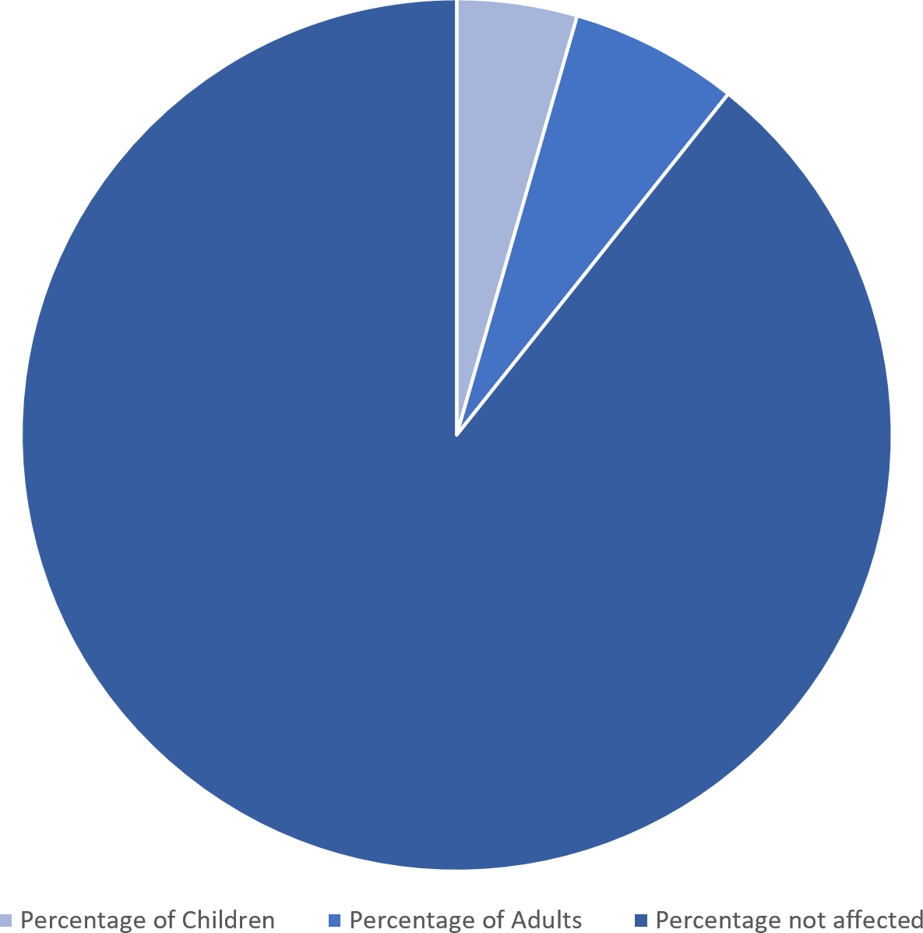
What is ADHD?
ADHD (Attention-Deficit/Hyperactivity Disorder)
is a neurodevelopmental condition that
affects both children and adults. It is
5%
7%
characterized by patterns of
inattention, hyperactivity, and
daily
impulsivity that interfere with
functioning or development.
ADHD manifests differently in individuals, and symptoms can vary in severity and presentation. Professionals from multiple disciplines collaborate to address ADHD comprehensively, reflecting its broad impact across health, education, and social domains. It is characterized by its chronic condition of unseemly levels of
88%
ADHD has a prevalence of approximately 5% in children and 7% in adults globally. ADHD presents a pressing public health challenge as it could affect families’ living and growth experiences.
hyperactivity,
inattention, and impulsivity.

Slide 3
ADHD in Children
Children with ADHD often display behaviours that are not typical for their age and developmental stage. These behaviours can fall into three main categories:
1. INATTENTION
Difficulty sustaining attention during tasks or play. Seeming not to listen when spoken to directly. Forgetfulness in daily activities (e.g., chores, homework).
2. HYPERACTIVITY
Fidgeting or tapping hands and feet. Running or climbing in inappropriate settings. Inability to play or engage in activities quietly. Difficulty staying seated when expected.
3. IMPULSIVITY
Blurting out answers before a question is completed. Difficulty waiting for their turn. Interrupting or intruding on others' conversations or activities.

Slide 4
ADHD in Adults
In adults, ADHD symptoms may persist but often present differently because of life demands and
coping mechanisms. Adults with ADHD may experience:
1. INATTENTION
Trouble prioritizing and completing tasks. Procrastination and difficulty meeting deadlines. Being easily distracted by irrelevant thoughts or stimuli. Difficulty maintaining focus during meetings or conversations.
2. HYPERACTIVITY (Often less obvious in adults)
Restlessness or an inability to relax. Feeling internally driven or "on edge." I Talking excessively or interrupting others in conversations.
3. IMPULSIVITY
Impulsive spending or risky decisions. Interrupting others or difficulty holding back thoughts. Acting without considering long-term consequences.

Slide 5
SUBJECT AREA

Slide 6
The topic of ADHD (Attention-Deficit/Hyperactivity Disorder) and related work falls into several interconnected
subject areas, depending on the specific perspective or focus:
The study of behaviour, cognition, and emotional regulation in
individuals with ADHD.
Focuses on understanding ADHD's impact on mental health and developmental processes.
A branch of medicine dealing with the diagnosis, treatment, and management of ADHD using therapeutic and pharmacological interventions.
CORE SUBJECT AREA
1. Psychology
2. Psychiatry
The study of brain structures and functions involved in ADHD.
Examines neurological underpinnings, such as differences in
brain activity, neurotransmitters, and executive functioning.
3. Neuroscience
4. Behavioural
Examines patterns of behaviour, environmental influences, and
interventions to manage ADHD symptoms.
INTERDISCIPLINARY SUBJECT AREAS
1. Public Health
Studies ADHD's societal impact, including prevalence, healthcare access, and policy implications.
Focuses on awareness, stigma reduction, and population-level interventions.
2. Sociology
3. Occupational
Therapy
Explores how ADHD affects relationships, family dynamics, and societal roles.
4. Developmental
Psychology
Supports individuals in managing ADHD symptoms in everyday activities and workplace settings.
Examines how ADHD influences growth, emotional development,
and behaviour over time.

Slide 7
WHY MACHINE LEARNING AND ARTIFICIAL INTELLIGENCE FOR ADHD?
Using Machine Learning (ML) and Artificial Intelligence (AI) for ADHD-related topics is compelling because these technologies can provide insights, tools, and interventions that significantly enhance understanding, diagnosis, treatment, and support.

Slide 8
HERE ARE SOME REASONS WHY ML AND AI ARE WELL-SUITED TO THIS FIELD:
Improved Diagnosis and Early Detection
Personalized Treatment Plans
Identifying Risk Factors
Enhanced Educational and Workplace Support
Large-Scale Public Health Insights

Slide 9
1. IMPROVED DIAGNOSIS AND EARLY DETECTION
Challenges in ADHD Diagnosis :
ADHD symptoms overlap with other conditions (e.g., anxiety, learning disabilities), making diagnosis complex and sometimes subjective.
AI Advantage :
Algorithms can analyse patterns in data, such as behavioural assessments, cognitive tests, or even speech and movement, to provide objective and early diagnoses.
AI-powered tools can process data from wearable devices or apps that
monitor activity levels, attention spans, and impulsivity in real-time.

Slide 10
2. PERSONALIZED TREATMENT PLANS :
Why:
ADHD affects individuals differently; some respond better to behavioural therapy, others to medication, or a combination.
AI Advantage :
Machine learning can analyse an individual's specific symptoms, genetics, lifestyle, and treatment history to recommend personalized intervention strategies.
Adaptive systems could track progress and fine-tune recommendations over time.
3. IDENTIFYING RISK FACTORS :
Challenge :
ADHD has genetic, neurological, and environmental risk factors, but their interplay is not fully
understood.
AI Advantage :
- Deep learning models can analyse complex datasets (e.g., genetic data, brain imaging,
environmental factors) to uncover hidden correlations and potential risk predictors.

Slide 11
4. ENHANCED EDUCATIONAL AND WORKPLACE SUPPORT
Why:
ADHD often leads to challenges in school and work environments, requiring tailored support.
AI Advantage :
Intelligent tutoring systems or virtual learning environments can adapt teaching methods in real-time to suit an ADHD learner's needs.
AI-powered productivity tools can help adults manage tasks, schedules, and focus challenges.
5. LARGE-SCALE PUBLIC HEALTH INSIGHTS
Why :
ADHD's prevalence and treatment vary across demographics, requiring population-level data to inform policies and healthcare.
AI Advantage :
- ML can process vast datasets from electronic health records, surveys, and research studies to identify trends, disparities, and areas needing intervention.

Slide 12
DATESET INFORMATION

Slide 13
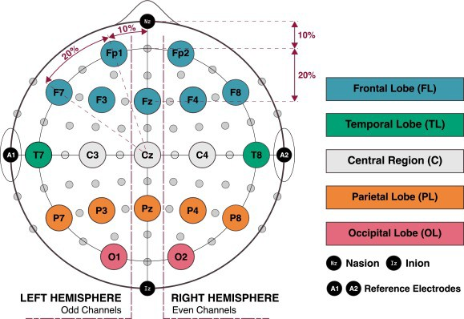
The IEEE data port made the dataset
used in this study publicly accessible. 121 youngsters between the ages of 7 and 12 have EEG records in this collection. 60 kids served as the control group, and 61 kids had ADHD.
The children in this dataset were diagnosed with ADHD based on the DSM-4 criteria by a qualified psychiatrist and had been taking Ritalin for a minimum of six months. There was no history of any mental illnesses among the children in the control group. An attention task based on visuals is used to
The kids were given a series of cartoon cart images as they were working on the job. Between five and sixteen cartoon
characters are randomly selected for each image, and they are all large enough to be plainly seen. Youngsters must determine how many characters are in the picture.
The length of each EEG records change based on how long it takes kids to finish an activity. This dataset has 19 EEG
channels (Fp1, Fp2, F3, F4, C3, C4, P3, P4, O1, O2, F7, F8, T7, T8, P7, P8, Fz, Cz, Pz) and a sampling frequency of 128 Hz.
This EEG data's electrode placement follows the International 10–20 method.

Slide 14
DATESET OVERVIEW

Slide 15
The dataset consists of 5540 rows and 400 columns, indicating a comprehensive set of EEG signal features
Column Information:
Columns include various power measurements and ratios from different EEG electrodes (e.g., Fp1_theta_power, Fp2_alpha_power, Pz_Theta_Beta).
The features appear to represent band power metrics for different EEG frequency bands (e.g., theta, alpha, beta) at various electrode positions (e.g., Fp1, Fp2, Fz).
The final column is target, which likely
represents the ADHD diagnosis label.
Data Types :
The features are all numerical (float64), suitable for machine learning models.
Sample of Features :
Examples of features include Fp1_theta_power, F3_alpha_power, and F8_Theta_Beta. These are likely derived from preprocessing EEG signals, such as calculating power spectral densities or ratios between frequency bands.
Excel Name: ADHD_Dataset_colab_seg.csv attaching the sample
Template for the same.
Target Column is ‘Target’ with binary values 0 or 1 where 1 represents
Class with ADHD and 0 indicates a class with no ADHD.

Slide 16
EEG PREPROCESSING

Slide 17
WORKING
Before analysing brain electrical activity, preprocessing procedures such as
eliminating physiological artifacts and non-physiological noise from EEG data are essential. For a methodical processing strategy, Python 3.11.5 and the MNE, Scipy module are employed throughout this section.
The IEEE dataport contains the EEG recordings in.mat file format. The files were converted to MNE Raw objects in order to deal with EEG data on the MNE library. Band pass filtering between 4Hz and 45Hz is done with a FIR filter.
Since this range includes the frequency that contributes to our analysis for the cognitive attention test, the filter is applied between 4 and 45 Hz. As a
result, we can rule out this frequency range.
A notch filter is applied at 50 Hz to guarantee that frequency and noise at this level are eliminated, even though a low-pass filter with a cutoff
frequency of 45 Hz was used. Power line noise often ranges from 50 Hz to 60
Hz, depending on the nation or region's voltage.

Slide 18
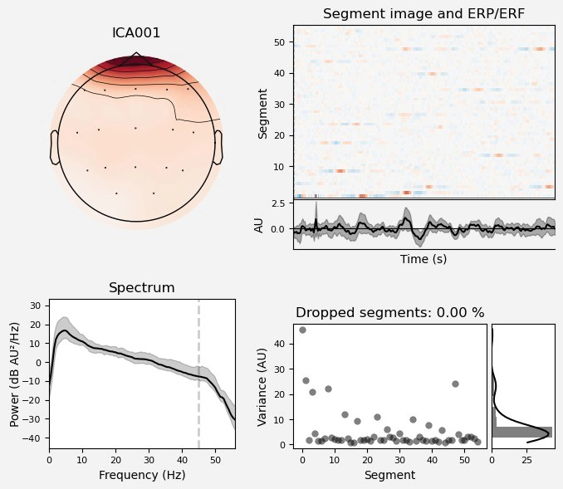
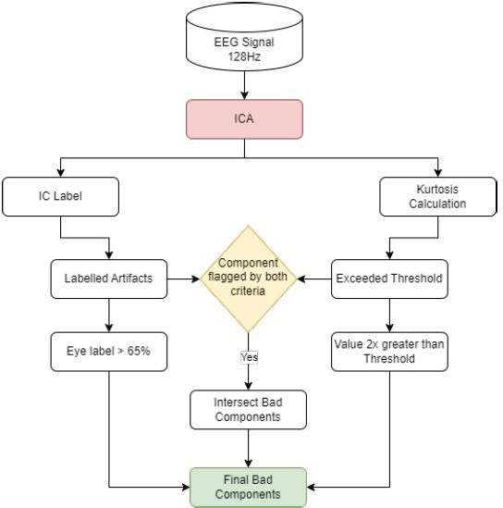
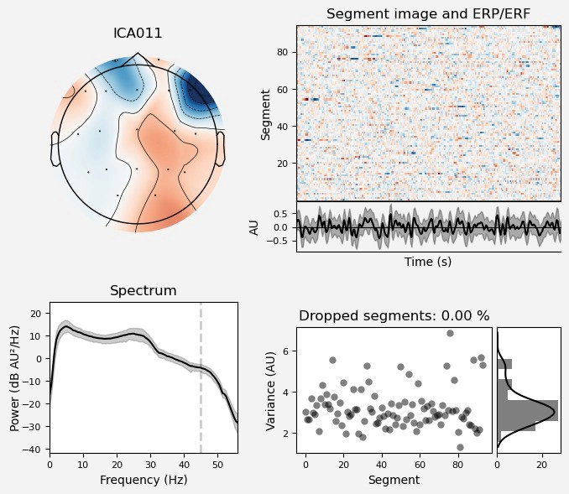
ARTIFACTS REMOVAL
The proposed systematic artifacts removal method applies a dual-criterion approach for analyse and identifying the artifactual components in EEG data.
Eye Blink Artifact
ICA are commonly used to split EEG signals into independent components that represent multiple sources of electrical activity in the brain or artifacts such muscle movement, eye blink, and channel noise.
Eye Movement Artifact

Slide 19
Data Segmentation
Preprocessed EEG data is divided into smaller parts and analyzed using the Hamming window approach. The segmentation structure consists of 4 second segments that overlap by 1 second..
The sample rate is set at 128 Hz. Each segment has 512 data points, which are smoothed using the Hamming window technique.
The Hamming window eliminates spectral leakage during frequency analysis of the segments.
After segmentation, the ADHD group consists of 3,091 instances, whereas the Control group consists of 2,449 instances, resulting in a total of 5,540 instances.

Slide 20
Feature Extraction

Slide 21
Features
1. Time Domain
Arithmetic Mean Standard Deviation Variance Skewness Kurtosis Hjorth Activity Hjorth Mobility Hjorth Complexity
2. Frequency Domain
Power Spectral Density Welch Method to calculate PSD Spectral Leakage are better counted PSD value are used to calculate absolute power of three key frequency theta, alpha and beta. Theta Beta Ratio is calculated
3. Time-Frequency Domain
Discrete Wavelet Transform(DWT) is applied Daubechies 4(db4) wavelet is used
These Features are extracted for each channel. Total of 400 features are obtained from this process. Below is the table for the all the brainwave and frequency range associated with all the features
Brainwave | Frequency Range | Associated State
Delta | 0.5 – 4 Hz | Deep sleep, healing.
Theta | 4 – 8 Hz | Relaxation, creativity
Alpha | 8 – 13 Hz | Calm focus, relaxation
Beta | 13 – 30 Hz | Active thinking, problem-solving
Gamma | 30+ Hz | Learning, memory

Slide 22
Machine learning and Neural Network Techniques

Slide 23
ML and Neural Network Models
We will be using Random Forest , Support Vector Machine and Multilayer Perceptron(MLP) Neural Network models.
1. Random Forest
Handles Non- Linearity Feature Importance Robust to Overfitting Handles Missing Data
2. SVM
Effective in High Dimensional Spaces Robust to Overfitting Small Sample Efficiency
3. MLP
Captures Complex Patterns Scalable and Customizable Handles Continuous Features
Random Forest, SVM, and MLP each bring unique strengths to the table, making them excellent candidates for a dataset with complex patterns (like EEG data) for ADHD classification. By employing all three, you benefit from their combined robustness, interpretability, and accuracy. This diversity can also aid in model comparison or ensemble approaches for better overall performance.

Slide 24
Results

Slide 25
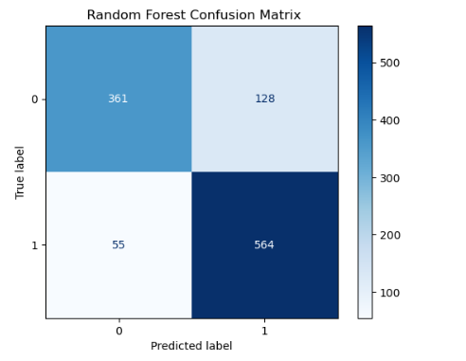
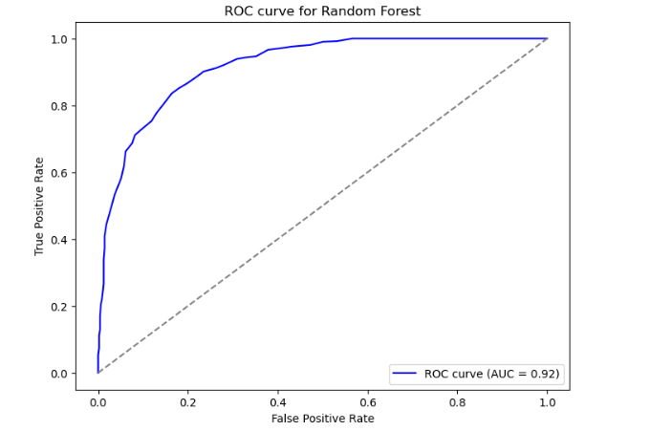
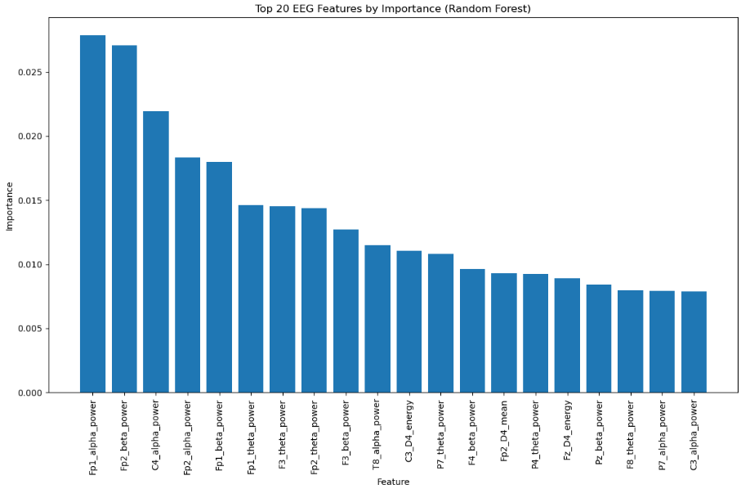
Random Forest
Random Forest Accuracy = 83%
Confusion Matrix
ROC- AUC Curve
Feature Importance

Slide 26
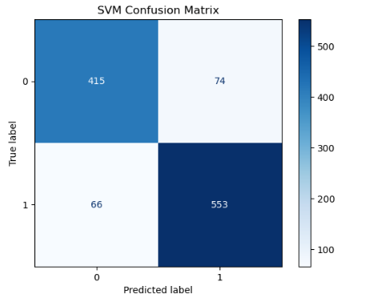
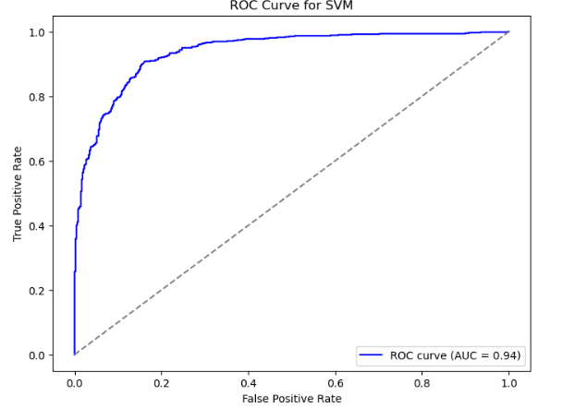
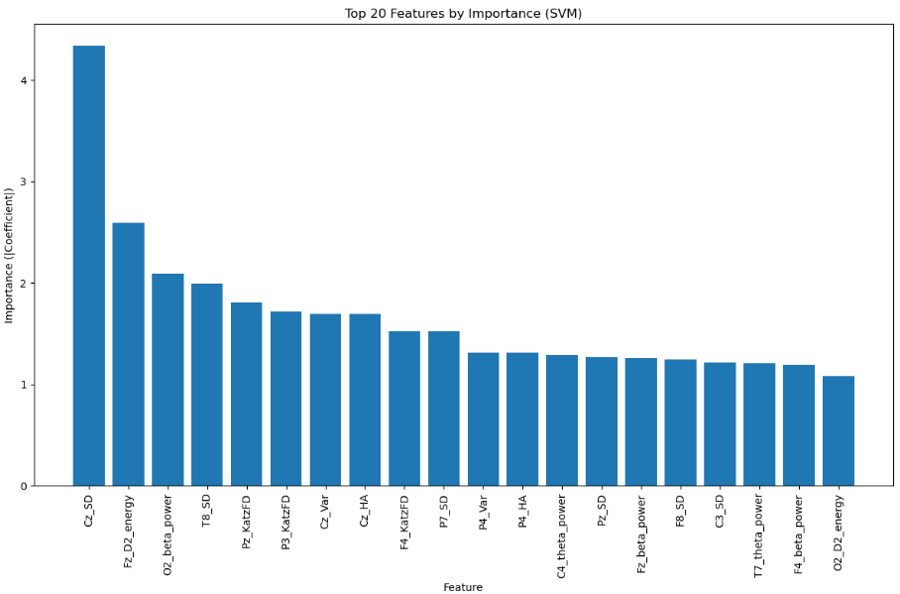
Support Vector Machine
SVM Accuracy = 87%
Confusion Matrix
ROC- AUC Curve
Feature Importance

Slide 27
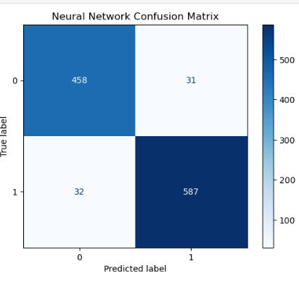
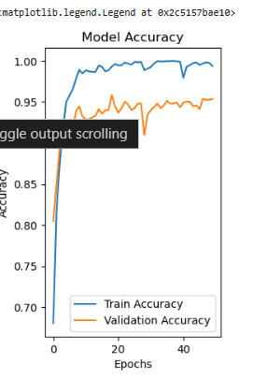
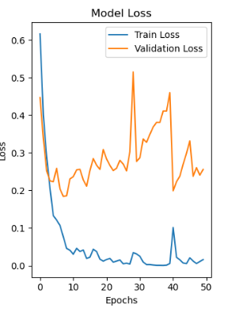
Multilayer Perceptron(MLP) Neural Network
MLP Accuracy = 94%
Confusion Matrix
Model Accuracy
Model Loss

Slide 28
Conclusion

Slide 29
Random Forest, SVM, and MLP each bring unique strengths to the table, making them excellent candidates for a dataset with complex patterns (like EEG data) for ADHD classification. By employing all three, you benefit from their combined robustness, interpretability, and accuracy. This diversity can also aid in model comparison or ensemble approaches for better overall performance.
The findings suggest that Neural Networks (MLP) are the most effective method for predicting ADHD in children using EEG signal features, achieving the highest accuracy of 94%. This makes it an ideal choice for real-world applications requiring high precision in diagnosis.
That said, Random Forest remains a valuable tool for its interpretability and feature selection capabilities, while SVM serves as a strong alternative, balancing performance and robustness. These models collectively provide complementary insights, and their combined use in ensemble learning could further enhance predictive accuracy and reliability in ADHD classification.

Slide 30
Future Work

Slide 31
Future Work
To further improve ADHD prediction in children using EEG signal features and machine learning, future research could consider the following directions:
1.Advanced Feature Engineering
Wavelet Transformation Time-Frequency Analysis Functional Connectivity Analysis
2. Model Optimization
Deep Learning Models( will be included in the research ) AutoML Frameworks Explainable AI
3. Multi Model Integration
Incorporating Clinical Data Sensor Fusion Edge Computing
Future work should focus on integrating advanced methods, larger datasets, and practical applications to refine ADHD prediction systems. By addressing these areas, researchers can enhance diagnostic accuracy, improve early detection, and contribute to personalized treatment strategies for ADHD.

Slide 32
Thank You

